Slide 1
8051 Microcontroller
Instruction Set

Slide 2
Trivia Time
Definition of instruction set
How does an instruction format looks?
What is operands?
What is an Opcode field?
Key point: All the units communicate through an 8-bit internal data bus

Slide 3
Instruction Set of 8051
The instructions supported by 8051 can be classified into different types depending upon the operation it performs.
Data transfer instruction
Arithmetic instruction
Logical instruction
Bit level logical instruction
Rotate and swap instruction
Branching instruction

Slide 4
Data transfer instructions
Operation: MOV
Syntax: MOV destination, source
Operation: MOVC
Function: Move Code Byte to Accumulator
Syntax: MOVC A,@A+register
Operation: MOVX
Function: Move Data To/From External Memory (XRAM)
SYNTAX: MOVX operand1,operand2
Description: MOVX moves a byte to or from External Memory into or from the Accumulator.

Slide 5
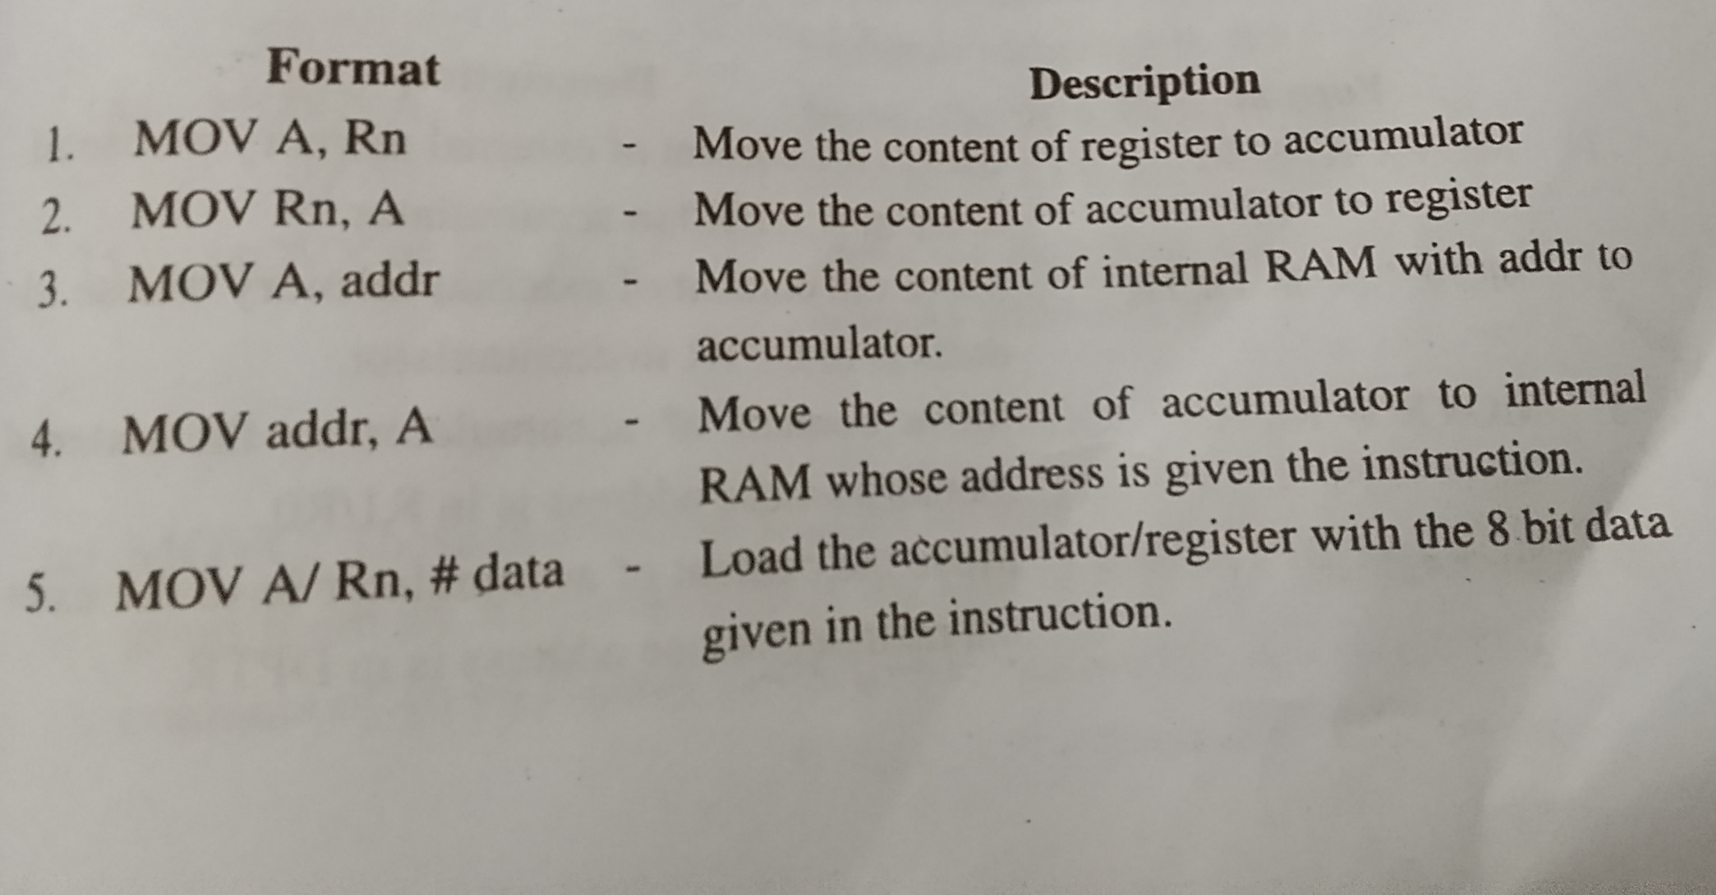

Slide 6
Operation: SWAP
Function: Swap Accumulator Nibbles
Syntax: SWAP A
Description: SWAP swaps bits 0-3 of the Accumulator with bits 4-7 of the Accumulator. This instruction is identical to executing "RR A" or "RL A" four times.
Operation: XCH
Function: Exchange Bytes
Syntax: XCH A,register
Description: Exchanges the value of the Accumulator with the value contained in register. Ex: XCH A, R1
Operation: PUSH | POP
Function: Push Value Onto Stack
Syntax: PUSH | POP
Description: PUSH "pushes" the value of the specified intRAM addr onto the stack.

Slide 7
Arithmetic Instructions
Operation: ADD, ADDC
Function: Add Accumulator, Add Accumulator With Carry
Operation: SUBB
Function: Subtract from Accumulator With Borrow
Operation: MUL
Function: Multiply Accumulator by B
Syntax: MUL AB
Operation: DIV
Function: Divide Accumulator by B
Syntax: DIV AB
Operation: INC Operation: DEC
Function: Increment Register Function: Decrement Register
Syntax: INC register Syntax: DEC register

Slide 8
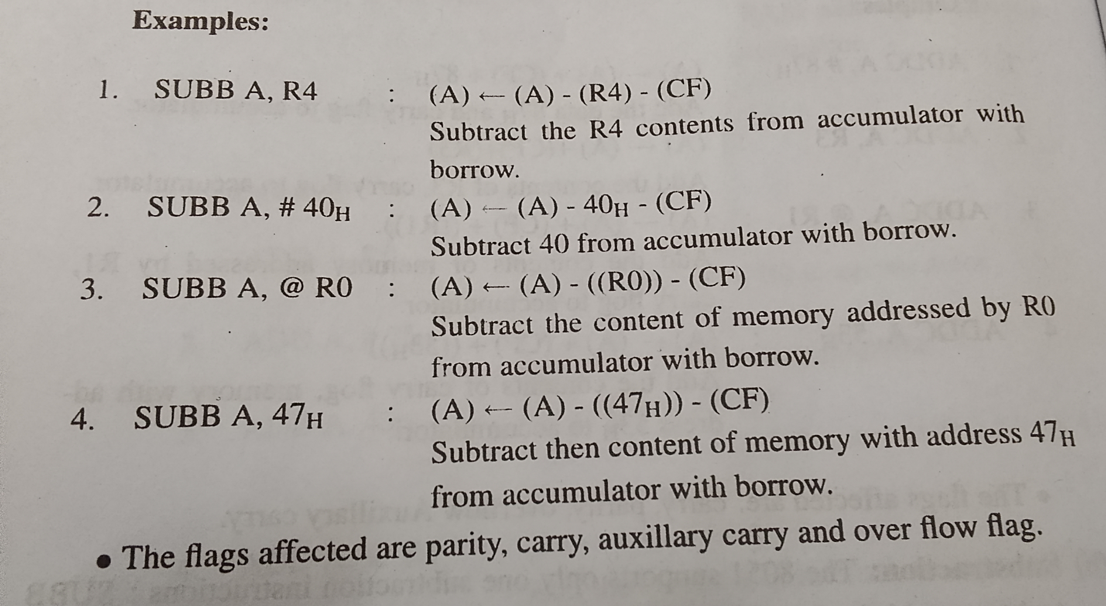

Slide 9
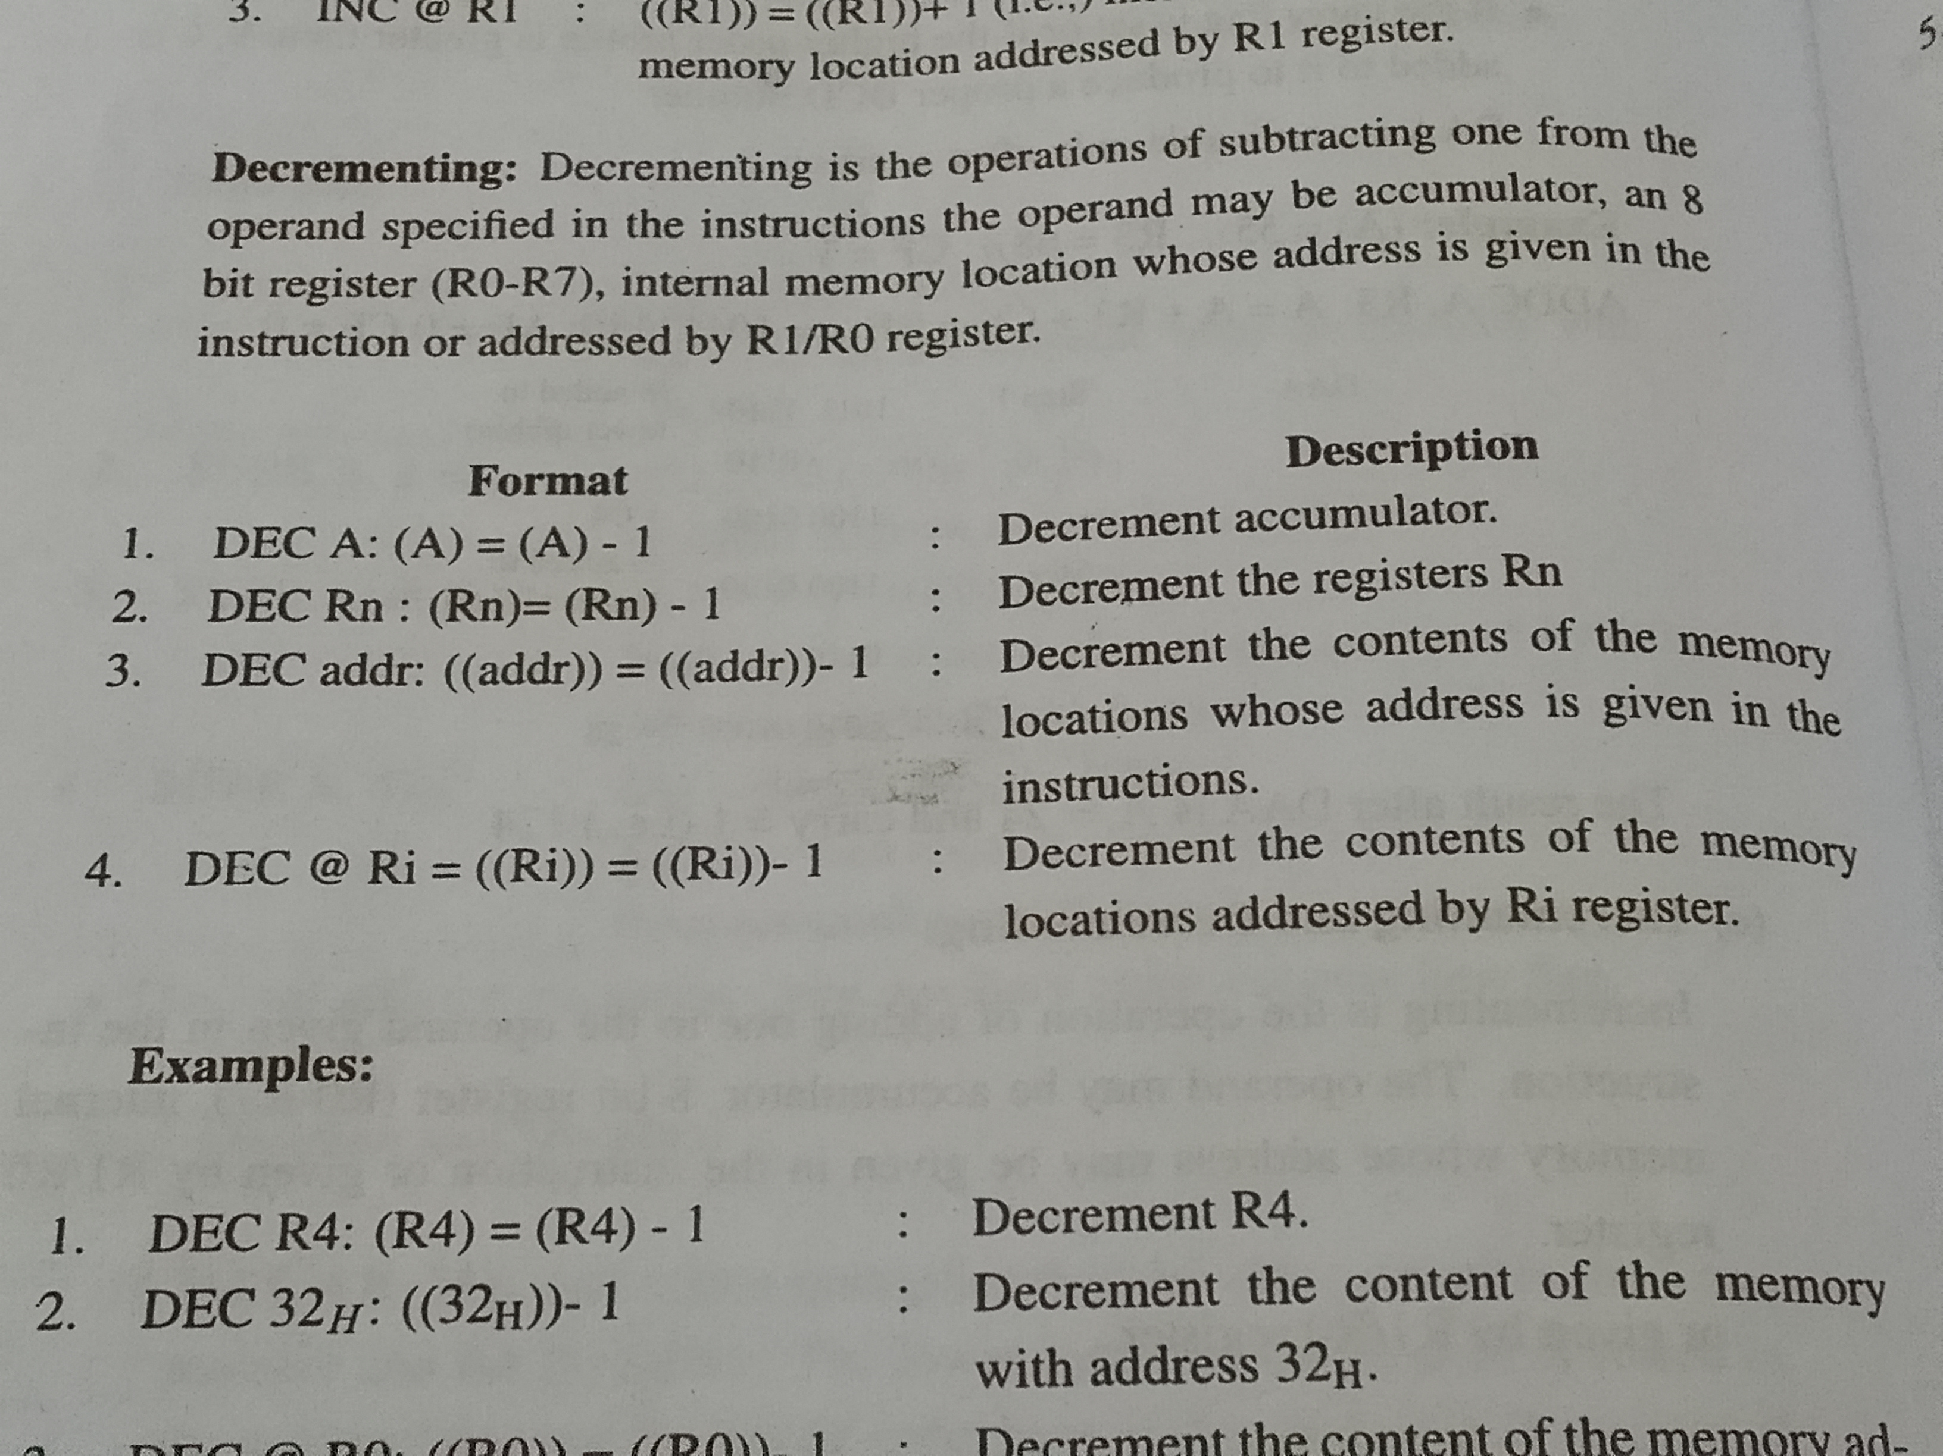

Slide 10
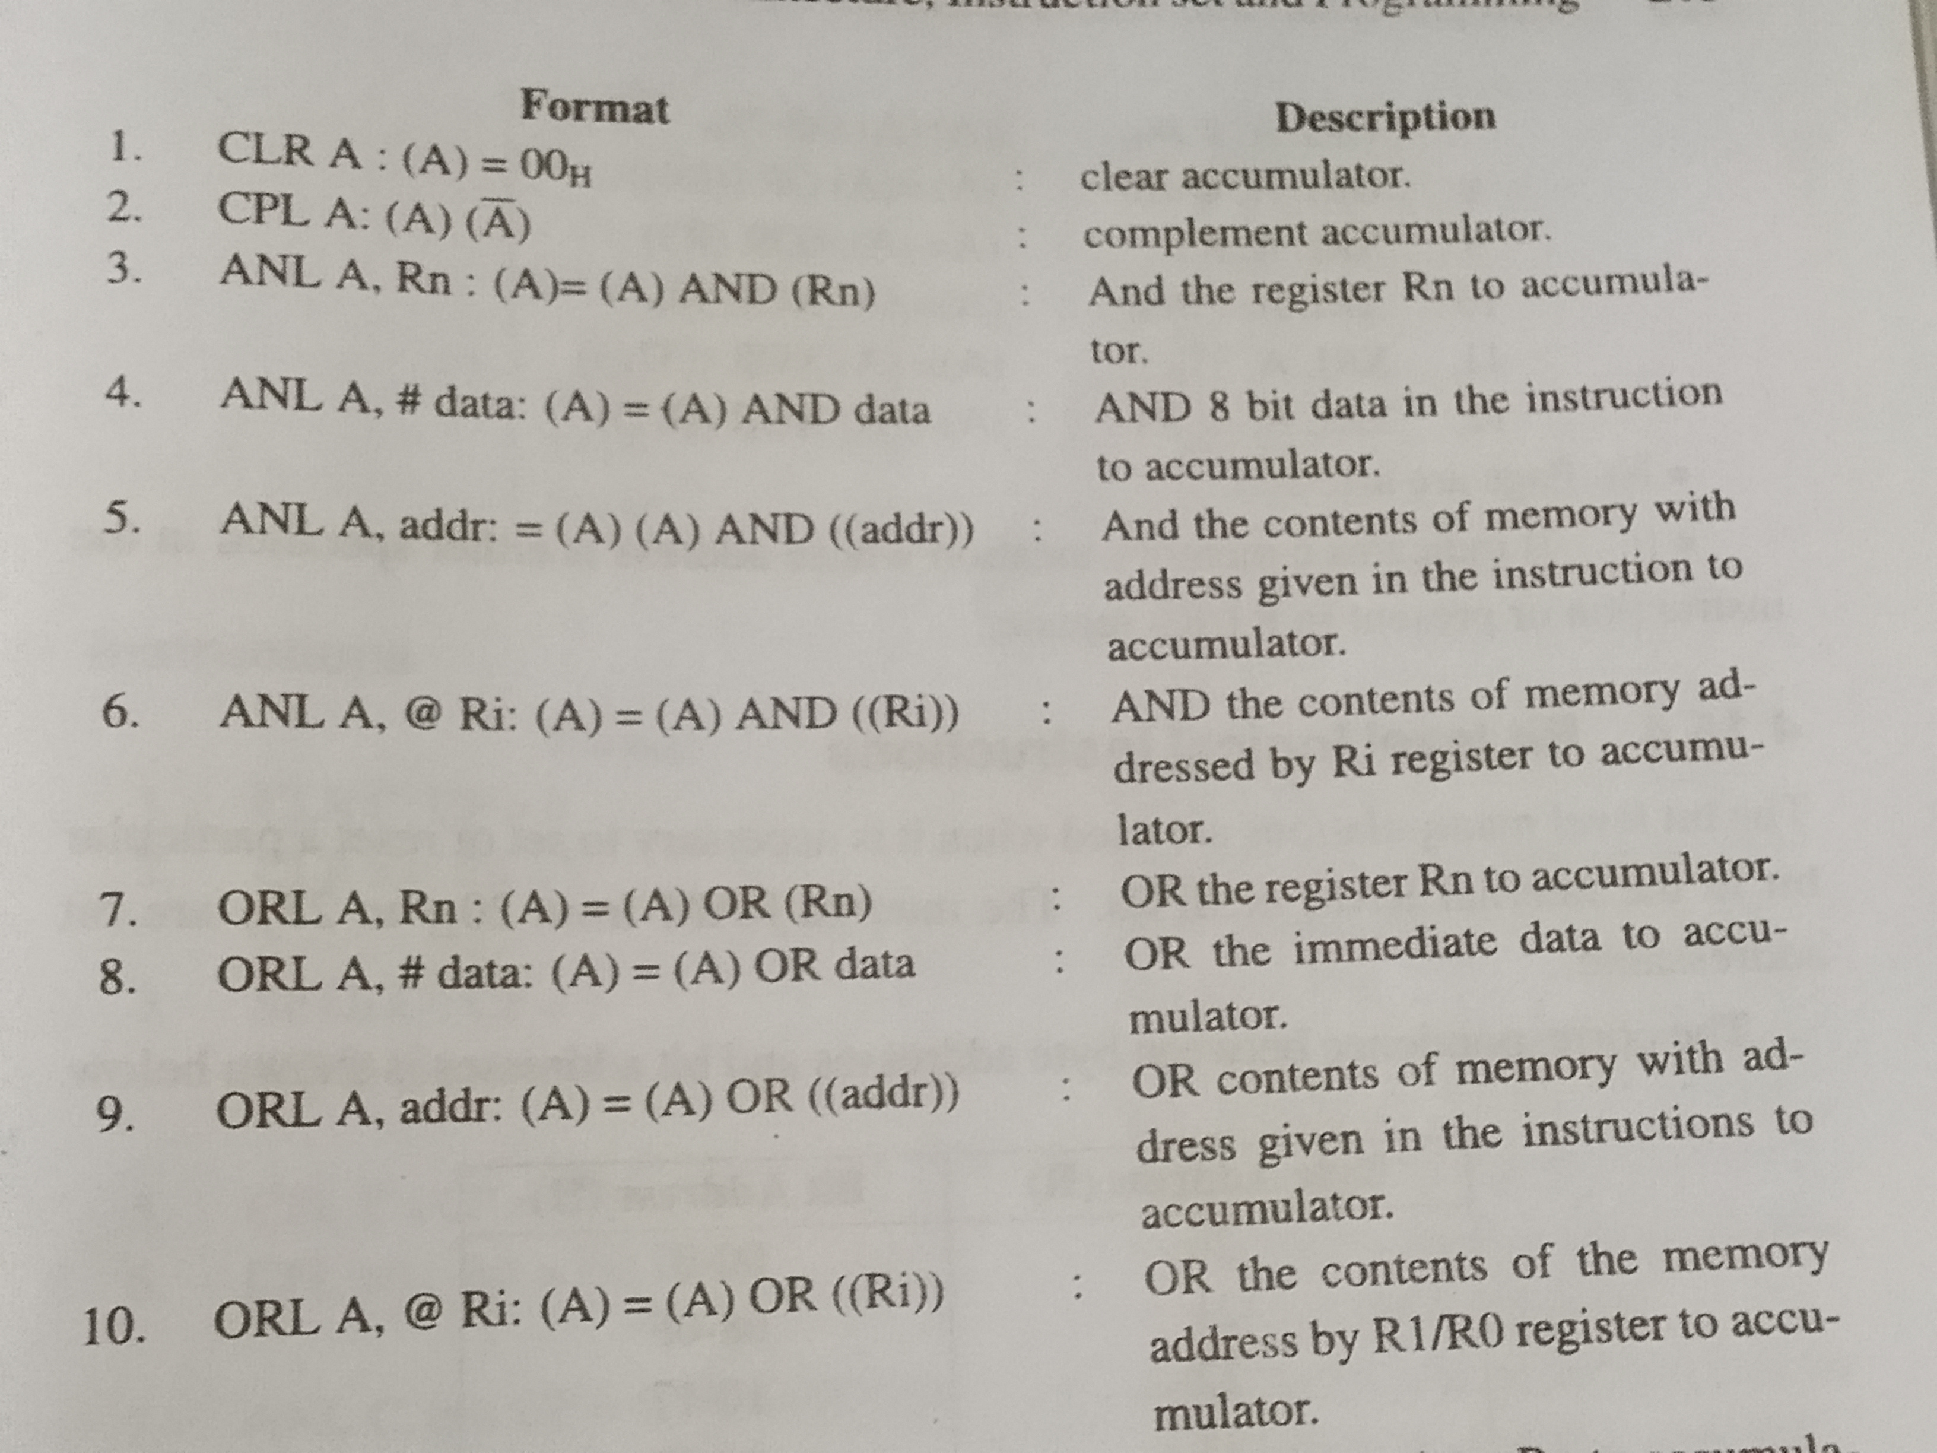
Logical Instructions

Slide 11
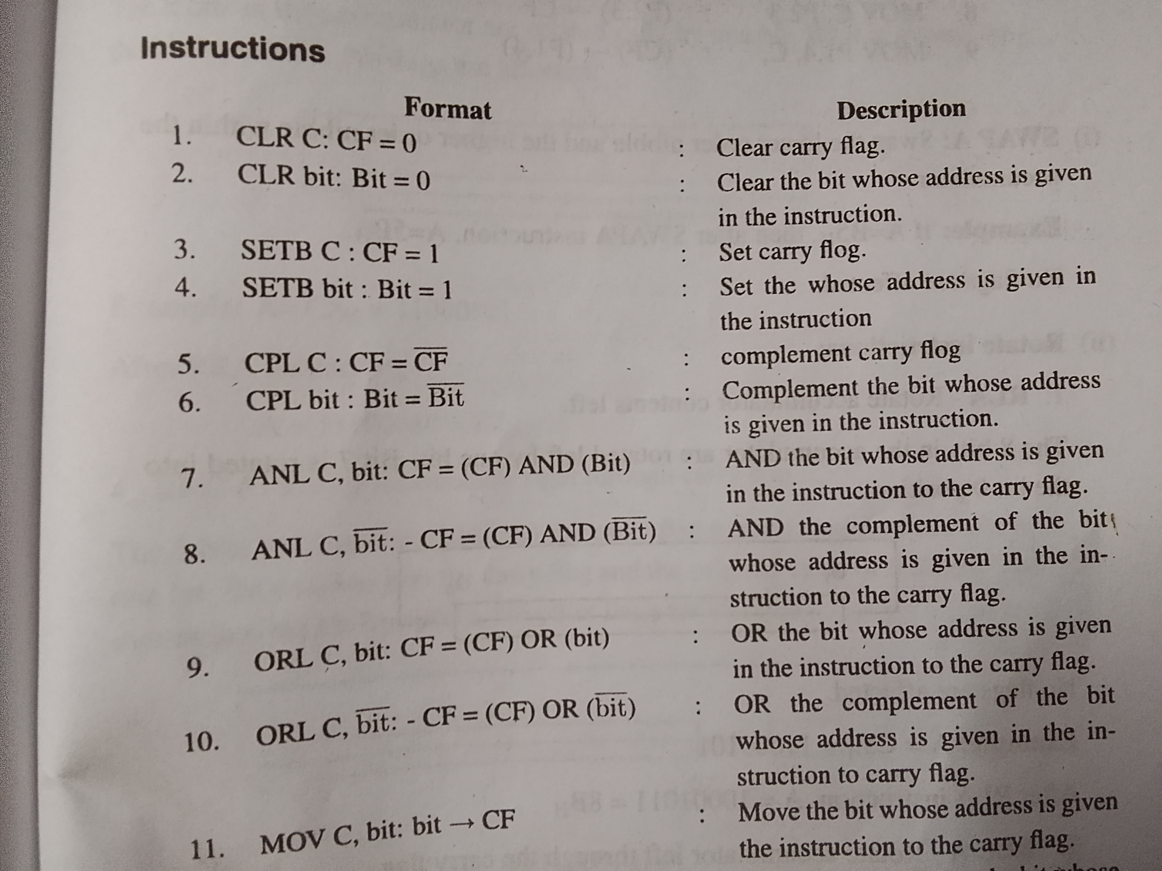
Bit Level Logical Instruction

Slide 12
Rotate and swap instruction
Supports left and right rotation without carry or swapping the operation
Operation: SWAP
Syntax : SWAP A
Rotate instruction:
RLA-Rotate accumulator contents left
RLC A-Rotate accumulator contents left through the carry flag
RRA- RLA-Rotate accumulator contents right
RRC A-Rotate accumulator contents right through the carry flag
EG:
A=C5H =11000101
A=10100011=8BH

Slide 13
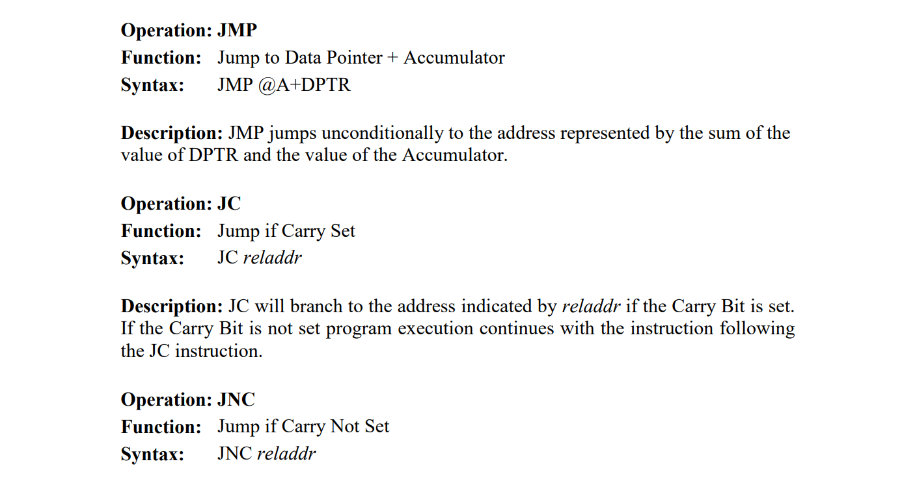
Branching Instructions

Slide 14
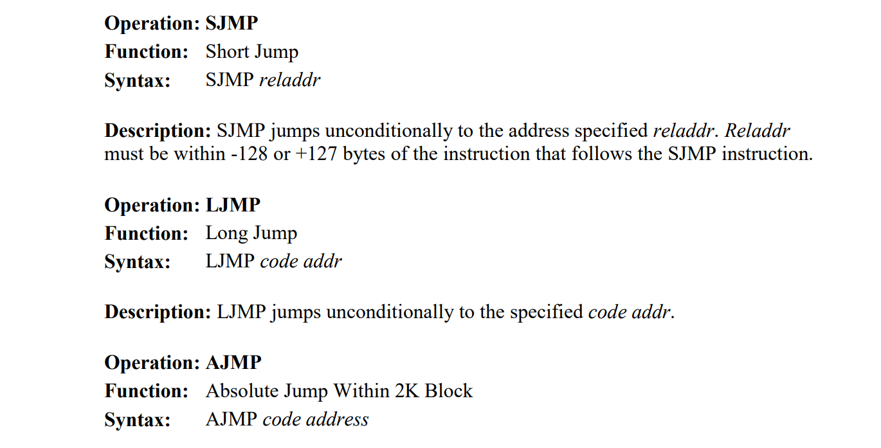
Unconditional jump instructions

Slide 15
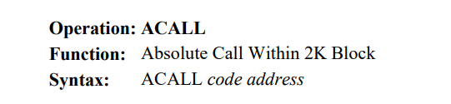
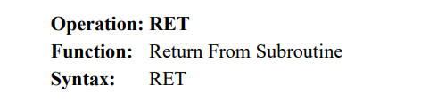
Call instructions

Slide 16
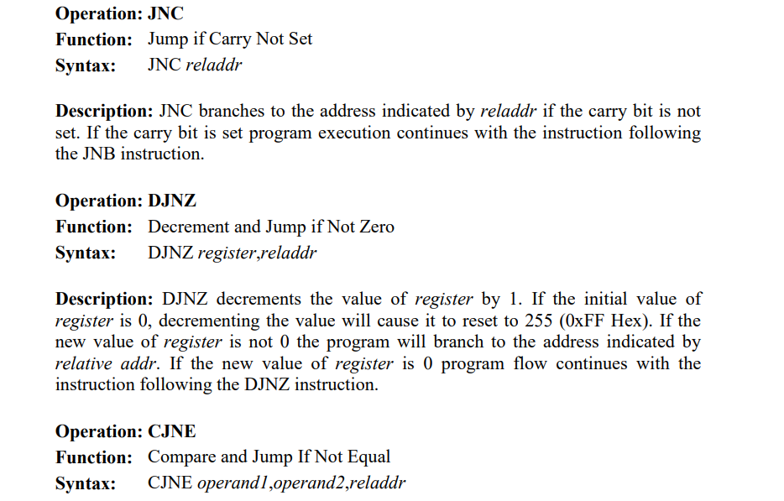
Compare and jump instructions:

Slide 17
Comparison between 8086 and 8051
Feature | 8086 Microprocessor | 8051 Microcontroller
Primary Word Size | 16-bit (operates on bytes or words) | 8-bit (operates on bytes)
Arithmetic Power | Hardware support for MUL and DIV (16-bit). | Supports MUL and DIV (8-bit), but limited.
Bit Manipulation | No dedicated bit-level instructions. Uses masking (AND/OR/XOR). | Complete Boolean Processor; can address individual bits (SETB, CLR, CPL).
Data Transfer | MOV, PUSH/POP, LEA, XCHG (extensive memory-to-register). | MOV, MOVX (external RAM), MOVC (program memory constant).

Slide 18
Comparison between 8086 and 8051
Branching/Flow | Near/Far calls and jumps for segmented memory. | Absolute (AJMP), Long (LJMP), and Short (SJMP) jumps.
Specialized Group | String instructions (MOVSB, CMPSB) for block data. | Boolean instructions for real-time control logic.

Slide 19
Thank you🙏🏻

